Slide 1
Caoileann Appleby
Strategy Director
caoileann@askdirect.ie
@ask_direct
Notes:
https://nfpsynergy.net/blog/overseas-aid-international-development-charity-future-challenges?mc_cid=c2cae4d313&mc_eid=d3773bbad7
“While it is easy to understand how a donation of £5 can help someone going hungry in a poorer country, it is a much bigger leap to explain how that same £5 can make a difference on a topic as seemingly intractable as climate change.”
https://www.dochas.ie/whats-new/first-results-from-worldview-project-baseline-survey-are-in/

Slide 2
You are not your audience
What they say =/= what they think =/= what they do

Slide 3
Our context: supporter focus
Qualitative interviews with100s of donors to various charities and causes, including international development
Quantitative supporter surveys (every 2-3 years)
Appeal results

Slide 4
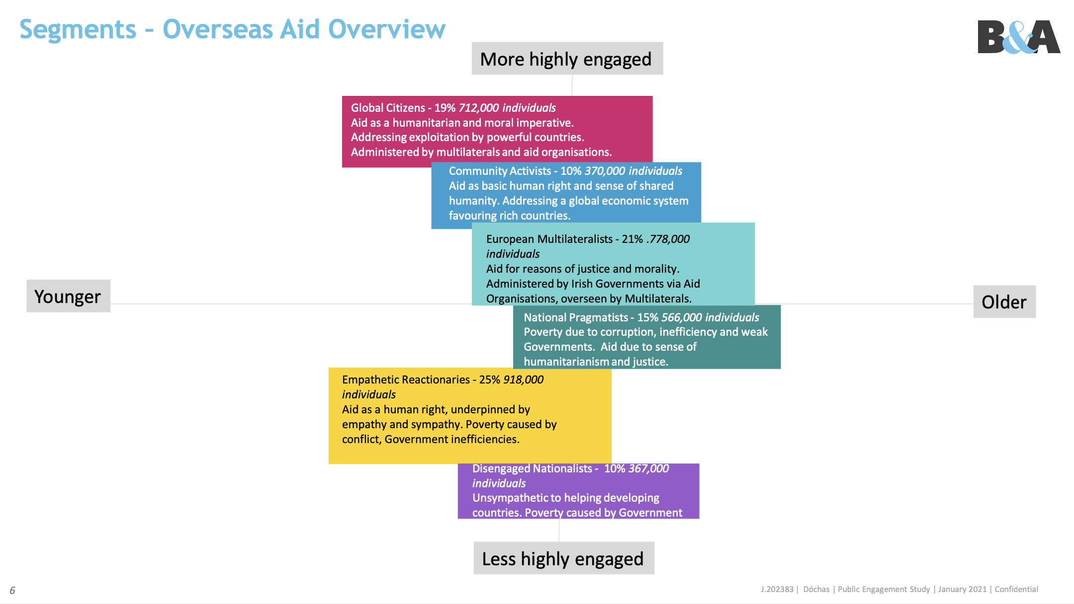
Focus on supporters:
Qualitative interviews 100s of donors to various charities and causes, including international development
Quantitative supporter surveys (every 2-3 years)
60+, donate to multiple charities
=> “national pragmatists” and “European multilateralists”

Slide 5
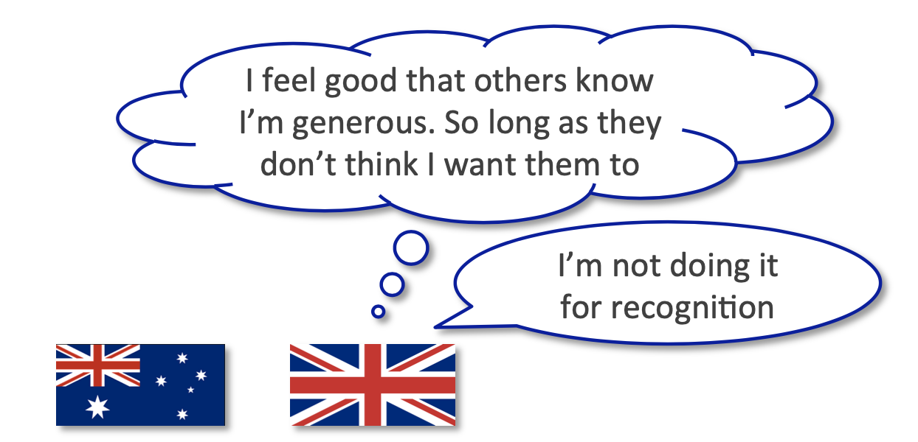
& Bluefrog Fundraising, MV donor research 2017

Slide 6
& Bluefrog Fundraising, MV donor research
If I have the money, I feel I have a responsibility to give something, you know;
not to spend everything on myself.

Slide 7
Core Donor Research, 2018
We were always taught in school to have a social conscience.
From the example of
my grandmother.
You should be giving something towards somebody. From my ma’s head.
In the main it comes from upbringing, an approach we were taught in school. I had an education by the Dominican nuns so there would have been a big emphasis on looking after people.
Notes:
Religious motivations: implicit > explicit (s18)
Moral obligation

Slide 8
I believe [the charity] have a lot of commitment from young idealistic people who go abroad, and they teach and they look after people who are hungry, they meet crises as they occur.
Notes:
Supporting intl development as part of Irish identity (s14)
Local-ness through community, and Irish people working abroad
Core Donor Research, 2018

Slide 9
[Our group] paid for one whole well. The joy it gave us to know that that money was going to help a whole village get clean water.
It was a real, real joy to us!
Notes:
Tangibility is key
Amorphous concepts like justice aren’t plausible
“fairness” > human rights, climate justice
https://nfpsynergy.net/blog/overseas-aid-international-development-charity-future-challenges?mc_cid=c2cae4d313&mc_eid=d3773bbad7
“While it is easy to understand how a donation of £5 can help someone going hungry in a poorer country, it is a much bigger leap to explain how that same £5 can make a difference on a topic as seemingly intractable as climate change.”
Mid Value Donor Research, 2017

Slide 10
I don’t get on a plane and ask the pilot to move over because
I don’t like the way he’s flying.
It’s the same thing really.
Notes:
International development supporters tend to feel more distant from the organisation than others

Slide 11
There’s one type of communication I’d like to see although it would probably be difficult, you see images of children and they’re absolute skin and bone and you say to yourself well they couldn’t last another day, now it would be nice to know in a few months how that child is, whether he or she is still alive. And the part that the onsite hospitals played in that. I’d like to pick out somebody and I’d talk to my grandchildren and I’d say look at what happened there with the few shillings we put in and you’d see Thomas in Uganda and he was almost gone and we brought him back to a healthy life.
Notes:
Want longer-term feedback; plausibility.
Core Donor Research, 2018

Slide 12
Caoileann Appleby
Strategy Director
caoileann@askdirect.ie
@ask_direct
Notes:
https://nfpsynergy.net/blog/overseas-aid-international-development-charity-future-challenges?mc_cid=c2cae4d313&mc_eid=d3773bbad7
“While it is easy to understand how a donation of £5 can help someone going hungry in a poorer country, it is a much bigger leap to explain how that same £5 can make a difference on a topic as seemingly intractable as climate change.”
https://www.dochas.ie/whats-new/first-results-from-worldview-project-baseline-survey-are-in/

